Slide 1


CAPSTONE PROJECT
TechCrush Capstone Project
TOPIC 4:
DEMONSTRATING FTP vs. SFTP SECURITY
Disclaimer: This training material belongs to techcrush and shouldn’t be shared

Slide 2
CAPSTONE PROJECT
Outline
TITLE
AIM AND OBJECTIVE
METHODOLOGY
CONCEPT OF PROJECT
TOOLS USED
FTP SETUP AND CONFIGURATION
FTP DATA EXPOSURE PROCESS
SFTP CONFIGURATION, EXECUTION AND FILE TRANSFER
SFTP ENCRYPTION MECHANISM
REFLECTION – WHY SECURE PROTOCOLS MATTER
Conclusion
References
THANK YOU
Disclaimer: This training material belongs to techcrush and shouldn’t be shared

Slide 3
CAPSTONE PROJECT
Title:-
Data in Transit; Comparative Analysis Demonstrating
FTP exposure
vs
SFTP encryption
Disclaimer: This training material belongs to techcrush and shouldn’t be shared

Slide 4
CAPSTONE PROJECT
Aim
To illustrate the risks of plaintext FTP transfers and how SFTP (via SSH) secures credentials and file contents.
Objectives
Build FTP and SFTP environments and transfer test.txt.
Capture traffic with Wireshark and show differences.
Explain SFTP encryption (key exchange, symmetric cipher, MAC).
Produce a comparative analysis and recommendations.
Disclaimer: This training material belongs to techcrush and shouldn’t be shared

Slide 5
CAPSTONE PROJECT
Methodology
The sequence of the demonstration went thus;
Configure VM networking (Bridged adapter).
2. Install & configure vsftpd (FTP) and SSH (SFTP).
3. Open necessary ports and configure passive range for FTP.
4. Transfer file using FTP client (Windows File Explorer) and SFTP client (PowerShell).
5. Capture traffic in Wireshark during both transfers.
6. Analyze captures, extract credentials and file contents for FTP, verify encrypted SSH packets for SFTP.
7. Summarize findings.
Disclaimer: This training material belongs to techcrush and shouldn’t be shared

Slide 6
CAPSTONE PROJECT
Concept of the Project
The project focuses on illustrating secure and insecure file transfer mechanisms through practical configuration and network analysis. It uses real-time tools, authentication procedures, and packet captures.
Disclaimer: This training material belongs to techcrush and shouldn’t be shared

Slide 7
CAPSTONE PROJECT
Tools Used
Function Tool Purpose
VM Networking VMware (Bridged) Connect client & server
FTP Server vsftpd (Kali) Plaintext file transfer
SFTP Server OpenSSH Secure encrypted transfer
Client Windows File Explorer, PowerShell FTP & SFTP testing
Packet Capture Wireshark Inspect traffic packets
Firewall ufw Open ports 21, 22,
and 40000–40100
Disclaimer: This training material belongs to techcrush and shouldn’t be shared

Slide 8
CAPSTONE PROJECT
FTP SETUP AND CONFIGURATION
File Transfer Protocol (FTP) is a standard network protocol used to transfer files between systems over a TCP/IP network. In this project, FTP is implemented to enable seamless file sharing between a Windows host system and a Kali Linux virtual machine.
The Kali Linux VM’s network adapter was first configured to Bridged mode in VMware. This connected it to the same network as the Windows host, allowing direct communication needed for FTP/SFTP file transfers
Reference: Fig 1.1 Bridged network adapter settings….full doc on google drive

Slide 9
CAPSTONE PROJECT
After the network adapter configuration, the FTP server was installed using the ‘sudo apt install vsftpd’ command. This is allows Kali host and manage FTP connections for incoming file transfers. After this, the FTP server is started.
Reference: Fig 1.2 FTP Server installation….full doc on google drive
The command ‘SUDO SS TULN | GREP :21’ was used to confirm that vsftpd or the FTP server is listening on port 21 and awaiting incoming FTP requests , meaning network communication is possible
Reference: Fig 1.4 FTP Connection Test….full doc on google drive
Disclaimer: This training material belongs to techcrush and shouldn’t be shared

Slide 10
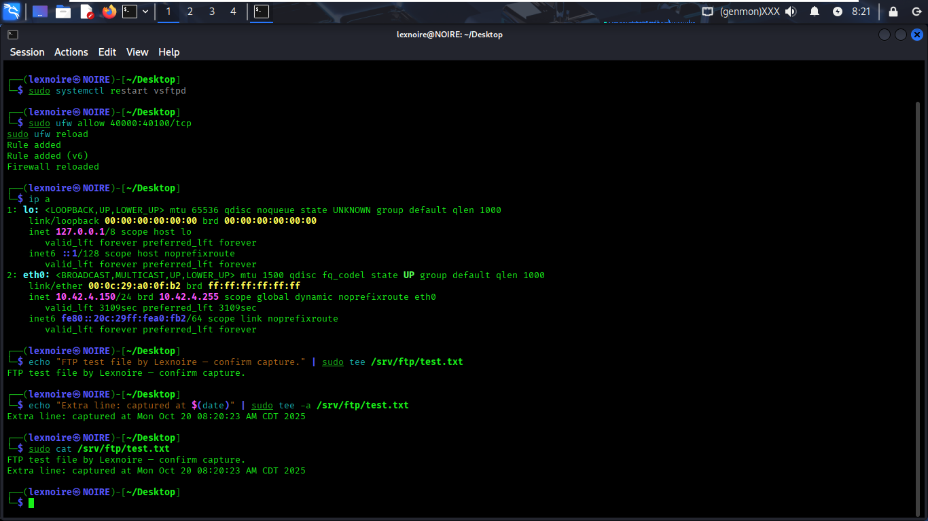

CAPSTONE PROJECT
A new, dedicated FTP directory/folder was created using ‘sudo mkdir -p /srv/ftp.’ The test file to be transferred ‘test.txt’ was then created in this folder and its content was entered using the echo command as shown in the image below.
After this, the FTP Protocol ‘FTP://10.42.4.150’ command was entered in the Windows File Explorer , the directory or folder content to be transferred was displayed, i.e; test.txt shown below. This indicates that Windows client (The File Explorer) was able to connect, authenticate and retrieve the file successfully from the Kali FTP server.

Slide 11
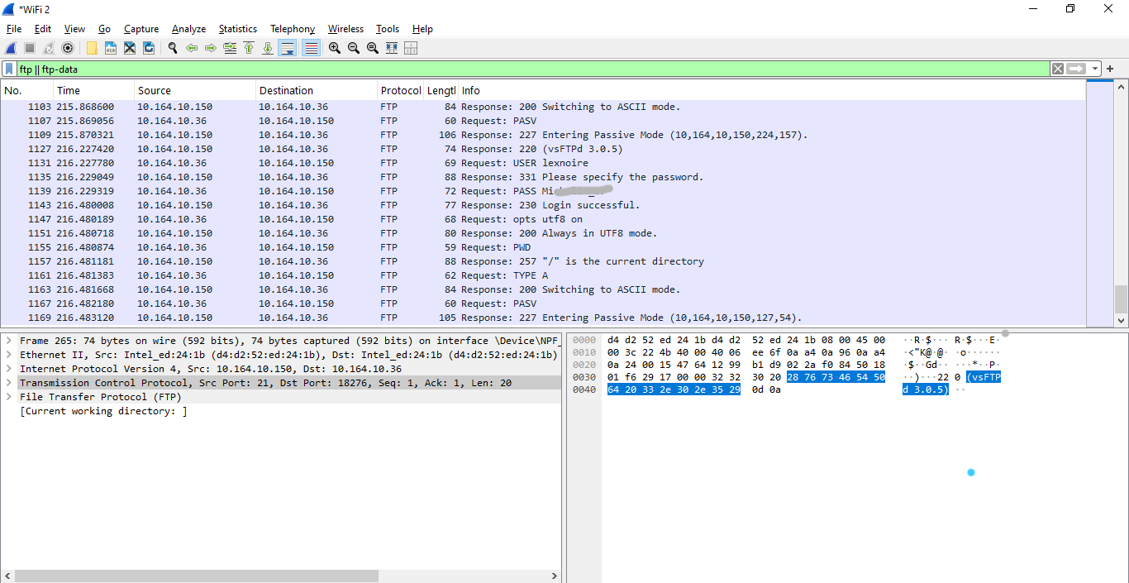
CAPSTONE PROJECT
FIG 2.1
After the file transfer, the filter ‘ftp || ftp-data’ was applied, to isolate and display every component of the File Transfer Protocol Session, revealing the USERNAME and PASSWORD of the FTP server, FILE SIZE AND CONTENT (see Fig 2.1 & 2.3 below). This shows that FTP is unencrypted and hence insecure.
.

Slide 12
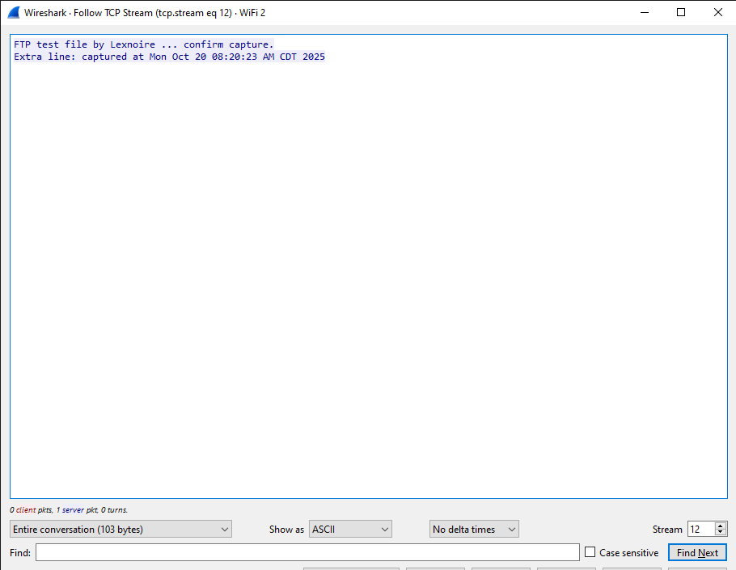
CAPSTONE PROJECT
FIG 2.3
Disclaimer: This training material belongs to techcrush and shouldn’t be shared

Slide 13
CAPSTONE PROJECT
FTP Data Exposure Process
1. Connect: Client opens an FTP control session to the server (TCP port 21)
2. Authenticate: The client sends USER <username> and PASS <password> over the control channel; these credentials are not encrypted and are visible to anyone sniffing the network.
3. Open Data Channel: For file transfer, FTP opens a separate data connection (server→client on a port the client provides), this channel carries data unencrypted.
4. Sniffing: An attacker able to intercept traffic (MITM, rogue AP) can capture both the control channel (credentials) and the data channel (file contents) with a packet sniffer like Wireshark.
5. Credential Reuse & Lateral Compromise: With plaintext credentials an attacker can log in as the user, upload or download files, or gain access to other systems.
6. Outcome: Full Account and Data Compromise
Resulting impact includes data theft, unauthorized modifications, malware insertion,e.t.c.

Slide 14
CAPSTONE PROJECT
SFTP File Transfer Configuration and Execution
Secure File Transfer Protocol (SFTP) enables secure file access, transfer, and management over an encrypted SSH (Secure Shell) connection, it provides end-to-end encryption, ensuring both authentication details and file contents are protected during transmission.
The SSH (Secure Shell) service is required for SFTP, it runs on top of SSH using port 22. The commands ‘sudo ufw allow 22/tcp,’ and ‘sudo ufw reload’ were used to open port 22 in the firewall as well as reload the rules to allow incoming SSH/SFTP connections and prepare the server for secure file transfer sessions
Reference: Fig 2.4 Network Configuration for SFTP….full doc on google drive
After the network configuration was completed, the file to be transferred was downloaded from the remote system KALI LINUX to the local working folder/directory- still on KALI LINUX, this was done to verify that;
The SFTP service was configured correctly
The user authentication was working
The transfer mechanism was operational before the file transfer was carried out on Windows
Reference: Fig 2.45 SFTP File Transfer and Verification….full doc on google drive
Disclaimer: This training material belongs to techcrush and shouldn’t be shared

Slide 15
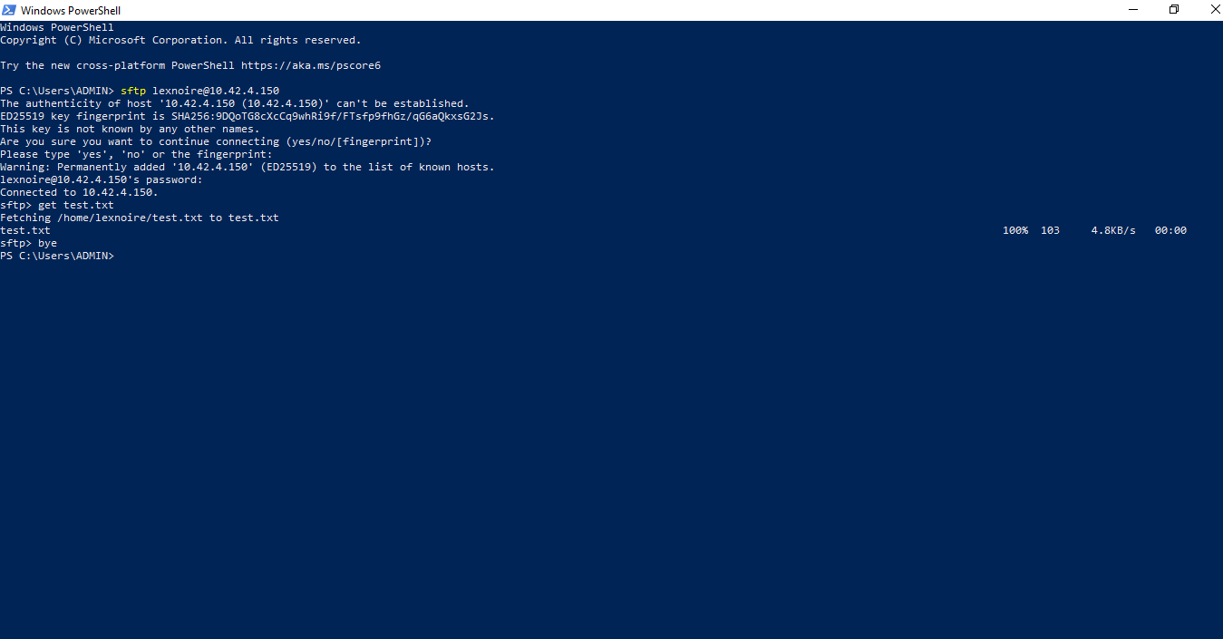
CAPSTONE PROJECT
Following the Verification, the command ‘sftp username@10.42.4.150’ was executed in Windows PowerShell to initiate a secure connection to the Kali server (IP 10.42.4.150), and then the file to be transferred was retrieved and saved on the Windows system from the Kali Server securely as shown below. (FIG 2.5)

Slide 16
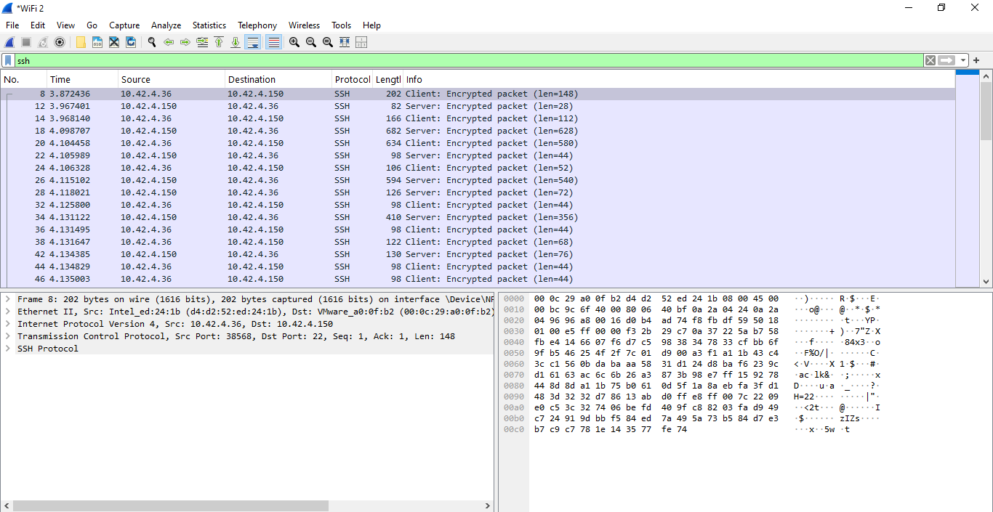
CAPSTONE PROJECT
The Wireshark ‘ssh filter’, was applied to isolate SSH packets captured during the SFTP file transfer. Unlike the FTP capture, which displayed readable credentials and file data, all SFTP packets appeared as ‘Encrypted packet’ entries. It can be seen below that all payload and data are encrypted in ciphertext showing that SFTP is far more secure compared to FTP.

Slide 17
CAPSTONE PROJECT
SFTP ENCRYPTION MECHANISM
Built on SSH: SFTP operates within a secure SSH tunnel, encrypting both commands and data.
Handshake Phase: Client and server negotiate algorithms and generate an encryption key using Diffie–Hellman or ECDH.
Server Authentication: The client verifies the server’s public key to confirm identity.
Data Encryption: Files and commands are encrypted with AES for confidentiality.
Integrity Protection: HMAC-SHA2 ensures packets aren’t tampered with during transfer.
Result: End-to-end encrypted, authenticated, and integrity-verified file transfers.

Slide 18
CAPSTONE PROJECT
Reflection – Why Secure Protocols Matter
Protect Sensitive Data: Encryption keeps information private and unreadable to outsiders.
Ensure Integrity: Secure protocols confirm that data isn’t altered or corrupted in transit.
Verify Authenticity: They validate identities, preventing impersonation or unauthorized access.
Build Digital Trust: Reliable communication fosters confidence between systems and users.
Strengthen Cybersecurity: In today’s threat landscape, secure protocols are vital for safe and stable operations.
Conclusion
FTP successfully enabled file transfers between systems but transmitted data, usernames, and passwords in plaintext, making it highly insecure.
SFTP (Secure FTP), on the other hand, uses SSH encryption, protecting all transmissions from eavesdropping or interception.
The project clearly demonstrates the security risks of legacy protocols like FTP and the importance of adopting encrypted alternatives.
In real-world environments, SFTP or FTPS should always replace traditional FTP for confidential or sensitive data transfer.

Slide 19
CAPSTONE PROJECT
REFERENCES
Template :Techcrush
Slide Notes:
Kali Linux Docs – vsftpd Server Setup, Offensive Security
Wireshark Foundation – FTP & SFTP Traffic Analysis
OpenSSH Project – SFTP Protocol Overview
VMware Docs – Network Modes
Project Files :
FTP & SFTP Configuration
Comparison of FTP and SFTP
SFTP Confidentiality and Integrity
Disclaimer: This training material belongs to techcrush and shouldn’t be shared

Slide 20
CAPSTONE PROJECT
THANK
YOU
Disclaimer: This training material belongs to techcrush and shouldn’t be shared

